Slide 1


Intro to Angular
HTTP Basics. Angular Overview. TypeScript Syntax.
SoftUni Team
Technical Trainers
Software University
http://softuni.bg

Slide 2
Table of Contents
HTTP Basics
Routing Overview
Angular Overview
Intro to TypeScript
Angular Installation & CLI
Demo

Slide 3
Have a Question?
sli.do
#js-web

Slide 4

HTTP Basics
HTTP Server - Client

Slide 5
HTTP
Hyper Text Transfer Protocol (HTTP)
Client-server protocol for transferring Web resources (HTML files, images, styles, etc.)
Important properties of HTTP
Request-response model
Text-based format
Relies on a unique resource URLs
Provides resource metadata (e.g. encoding)
Stateless (cookies can overcome this)

Slide 6
HTTP: Request-Response Protocol
Client program
Running on end host
E.g. Web browser
Requests a resource
Server program
Running at the server
E.g. Web server
Provides resources

Slide 7
HTTP: Request-Response Protocol (2)
GET /index.html
HTTP/1.0
HTTP/1.0 200 OK
"Welcome to our
Web site!"

Slide 8
Example: Hyper Text Transfer Protocol
HTTP request:
HTTP response
GET /courses/about.aspx HTTP/1.1
Host: www.softuni.com
User-Agent: Mozilla/5.0
<CRLF>
End of request header
HTTP/1.1 200 OK
Date: Mon, 5 Jul 2010 13:09:03 GMT
Server: Microsoft-HTTPAPI/2.0
Last-Modified: Mon, 12 Jul 2010 15:33:23 GMT
Content-Length: 54
<CRLF>
<html><title>Hello</title>Welcome to our site</html>

Slide 9
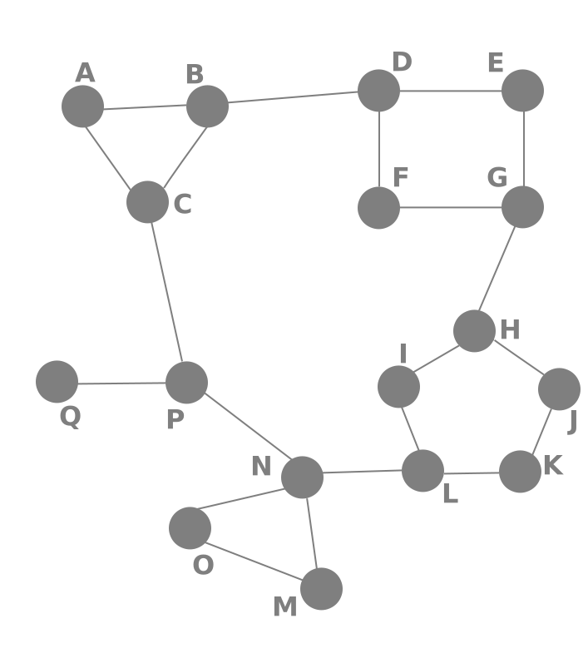
Routing Overview
Navigation for Single Page Apps

Slide 10


What is Routing?
Routing allows navigation, without reloading the page
It's a pivotal element of writing Single Page Applications
Link
HTML
Router
Link
Link
Link
Standard Navigation
Navigation using Routing

Slide 11

Single Page Applications
A Router loads the appropriate content when the location changes
E.g. when the user manually enters an address
Conversely, a change in content is reflected in the address bar
E.g. when the user clicks on a link
Benefits:
Load all scripts only once
Maintain state across multiple pages
Browser history can be used
Build User Interfaces that react quickly

Slide 12


Angular Overview
What The Fuzz Is All About ?

Slide 13
What is Angular?
Angular is a platform for building complex front-end apps
Focused on end-to-end tooling and best practices
Developed by the Angular team at Google
import { Component } from '@angular/core';
@Component({
selector: 'my-app',
template: `<h1>Hello {{name}}</h1>`
})
export class AppComponent { name = 'Angular'; }

Slide 14
Angular Versions
Angular 7
Angular 1
Angular 6
Complete Re-Write
…
"AngularJS"
Angular 2
Just "Angular"

Slide 15

Angular pros and cons in 2019
Benefits of Angular
New features like enhanced RXJS, faster compilation (in under 3 seconds), new HttpClient launch
Detailed documentation that allows getting all necessary information
Two-way data binding
MVVM (Model-View-ViewModel)
Dependency injection and modularity

Slide 16

Angular pros and cons in 2019 (2)
Drawbacks of Angular
The complex syntax that comes from the first version of Angular. (AngularJS)
Migration issues which can appear while moving from the older version to the latest ones.

Slide 17

Introduction To TypeScript
A JavaScript Superset

Slide 18
Introduction To TypeScript
Install globally via npm
TypeScript uses the .ts file extension (supported by VS Code)
To compile your code
Compilation output is plain JavaScript
npm install -g typescript
tsc myfile.ts

Slide 19
Variable Types
let isDone: boolean = false;
let decimal: number = 6;
let hex: number = 0xf00d;
let binary: number = 0b1010;
let octal: number = 0o744;
let color: string = "blue";
color = 'red';
let list: number[] = [1, 2, 3];
let list: Array<number> = [1, 2, 3];
More info at typescriptlang.org/docs/handbook/basic-types.html

Slide 20
Classes
Access modifier could be public/private/protected
class Greeter {
public greeting : string;
constructor(message : string) {
this.greeting = message;
}
greet() : string {
return `Hello, ${this.greeting}`;
}
}
let greeter : Greeter = new Greeter("world!");
console.log(greeter.greet());
Functions could also have a return type

Slide 21
Inheritance
class Animal {
move(distanceInMeters: number = 0) : void {
console.log(`Animal moved ${distanceInMeters}m.`);
}
}
class Dog extends Animal {
bark() : void {
console.log('Woof! Woof!');
}
}
const dog = new Dog();
dog.bark();
dog.move(10);
dog.bark();

Slide 22
Interfaces
function printLabel(labelledObj: { label: string }) {
console.log(labelledObj.label);
}
let myObj = {size: 10, label: "Size 10 Object"};
printLabel(myObj);
Property assertion
interface LabelledValue {
label: string;
}
function printLabel(labelledObj: LabelledValue) { … }

Slide 23
Generics and Enumerations
function identity<T>(arg: T): T {
return arg;
}
let output = identity<string>("myString");
// type of output will be 'string'
let output = identity(5);
// type of output will be 'number'
Type inference
enum Direction {
Up = 1,
Down,
Left,
Right,
}

Slide 24
Modules
export default interface StringValidator {
isAcceptable(s: string): boolean;
}
export { ZipCodeValidator };
export { ZipCodeValidator as mainValidator };
import { ZipCodeValidator } from "./ZipCodeValidator";
import * as validator from "./ZipCodeValidator";
import num from "./OneTwoThree";

Slide 25



Angular Installation
Packages, Setup, Structure

Slide 26
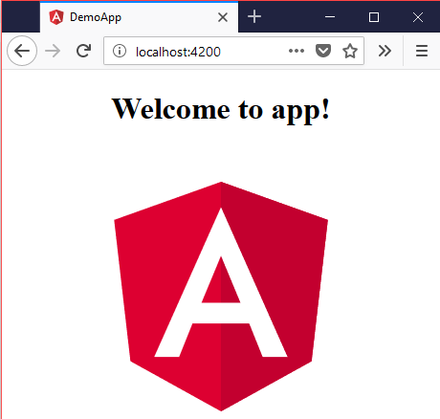
Creating A New App
Install globally via npm
Create new project
Start a dev server on port 4200
npm install -g @angular/cli
ng new some-app
cd some-app
ng serve

Slide 27
Finding Information
Visit the official website
Documentation
Online sandbox
https://angular.io/
https://angular.io/docs
embed.plnkr.co/ ?show=preview&show=app%2Fapp.component.ts

Slide 28



IDE Support
Visual Studio Code fully supports TypeScript
You may use your favorite IDE (most have plugins)
By using the Angular CLI
You do not need to use a linter
You do not need install any specific plugin
Everything is included

Slide 29
Live Demo
A simple Angular App!

Slide 30

Summary
Angular is a framework for front-end apps
TypeScript is JavaScript superset language
The Angular CLI is a complete toolkit for working with Angular
…
…
…
interface LabelledValue {
label: string;
}
function print(labelledObj: LabelledValue) { … }

Slide 31
https://softuni.bg/courses/angular-2-fundamentals

Slide 32













SoftUni Diamond Partners

Slide 33




SoftUni Organizational Partners

Slide 34




Trainings @ Software University (SoftUni)
Software University – High-Quality Education and Employment Opportunities
softuni.bg
Software University Foundation
http://softuni.foundation/
Software University @ Facebook
facebook.com/SoftwareUniversity
Software University Forums
forum.softuni.bg

Slide 35

License
This course (slides, examples, demos, videos, homework, etc.) is licensed under the "Creative Commons Attribution-NonCommercial-ShareAlike 4.0 International" license

